Slide 1

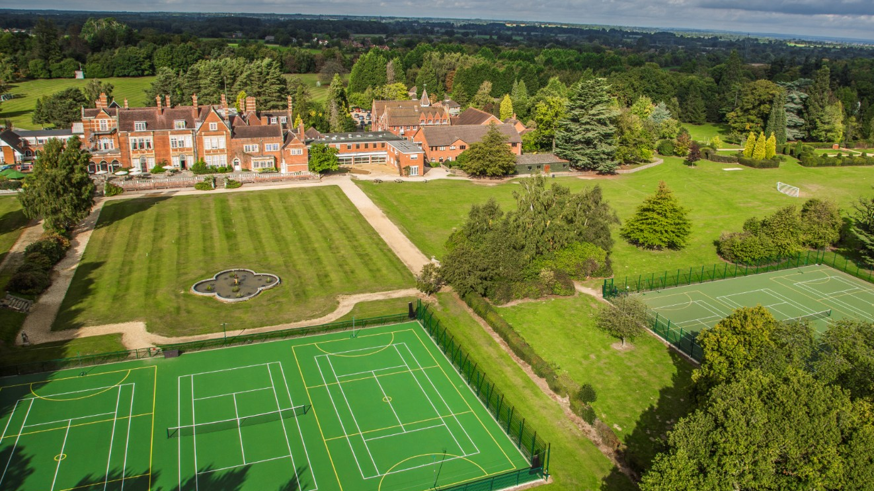
Breakfast Menu
 | Monday | Tuesday | Wednesday | Thursday | Friday | Saturday | Sunday
HYDRATION STATION | Mint & Cucumber Infusion | Autumn Berry Infusion | Orange, Lemon & Lime Infusion | Sparkling Elderflower & Pear Infusion | Watermelon & Mint Infusion
BREAKFAST FROM THE GLOBE | Continental Selection of Meats, Cheeses and Breads, Warm Danish Pastries, Boiled Eggs | Scrambled Eggs Avocado on Sour Dough Bread | Poached Eggs, Baked Beans, Toast, Mushrooms with spinach | Baked mushrooms Roasted Tomatoes Breakfast Frittata | Oven Cooked Potato Hash Brown, Smoked Bacon, Butchers Sausages, Scrambled Eggs, Baked Beans, Black Pudding, Mushrooms, Grilled Tomatoes Wholegrain Toast
EVERYDAY ​
Gluten Free Cereals​
Gluten Free Porridge Station​
Cereal Station​
Yoghurt Station​ & Gluten free Granola, Berries
Whole meal Toast & Preserves​​
Fresh Cut and Whole Fruits​
​
Autumn
2

