Slide 1

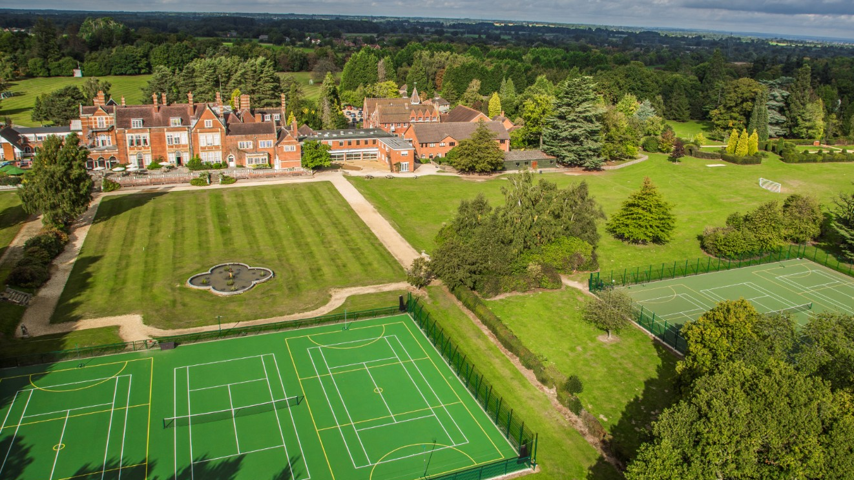
Lunch Menu
WEEK ONE | Monday | Tuesday | Wednesday | Thursday | Friday
MAIN COURSE ONE MEAT FREE MONDAYS | Vegetarian sausage casserole with Butter beans or Mushroom stroganoff served with wholegrain Rice (GF and DF option available) | Smoked Paprika Marinated Chicken served with roast potatoes & Seasonal vegetables (GF and DF option) | Minced Lamb Tagine Lamb mince in tomato sauce served with whole-wheat pasta (GF and DF option available) | Mild Chicken Korma served with whole-grain rice (GF and DF option available) Chicken Option Available for Halal | Sherfield Chip Shop Friday MSC Fish Breaded Cod Fillet Fish Finger G/F fish Finger (GF and DF option – Plain Grilled Fish) Seafood Gratin
MAIN COURSE TWO | Vegan Sweet Potato & Chickpea Enchiladas (V) | Beetroot & Squash Wellington with kale Pesto Plant-based/Vegan (V) | Vegetable Lentil & Chickpea Tagine served with Cous cous Vegan (V) Gluten Free | Sri Lankan Eggplant Curry(V) | Meat Free Spicy Bean Burger (V)
ON THE SIDE | Trimmed French Greens Crushed New Potatoes Sweetcorn | New Potatoes Carrots & Peas | Roasted New Potatoes Spring Greens swede Roast Potatoes Gravy | Wholegrain Rice Naan Bread Mint Yoghurt Sautéed spinach & sweet Potato | Chunky Chips Garden Peas Baked Beans Chip Shop Curry Sauce Homemade Tartar Sauce Lemon Wedge & Pickles
HOT OR COLD DESSERT | Jelly, fresh fruit, Homemade yoghurt, fruit topping | Traditional Gluten Free Flapjack | Jelly, fresh fruit, Homemade yoghurt, fruit topping | Chocolate Tray bake | Oat & Sicilian Lemon Cookies
EVERYDAY Homemade Soup of the Day Served with Freshly Made Bread Extensive Salad Bar Jacket Potatoes with Baked Beans & Grated Mature Cheddar and a Daily Hot Filling Fresh Cut and Whole Fruits Natural Homemade Yoghurt and Compote
Week 1

Slide 2
Lunch Menu
WEEK TWO | Monday | Tuesday | Wednesday | Thursday | Friday
MAIN COURSE ONE MEAT FREE MONDAYS | Vegetarian Shepherd’s Pie Or Leek & Butterbean Gratin (V) | Sausages A selection of butchers’ sausages, served with crushed new potatoes, Gravy (GF and DF option Available) | Sweet Chilli Chicken served with noodles Or Rice (GF and DF option available) Halal | Beef Bourguignon, Braised beef with sliver skin onions, bacon lardons, mushrooms in a rich sauce (GF and DF option available) | Sherfield Chip Shop Friday MSC Fish Breaded Cod Fillet Fish Finger G/F fish Finger (GF and DF option – Plain Grilled Fish (Mackerel)
MAIN COURSE TWO | Pesto & Cherry Tomato Pasta (V) | Plant-based Quorn Vegetarian Sausages (V) (Vegan) | Hoi Sin Pulled Oumph served with rice Noodles (V) | Vegan Moussaka (V)(Vegan) | Wild Mushroom Risotto with Truffle Oil (V)
ON THE SIDE | Sweetcorn Broccoli | Crushed New Potatoes Carrots & Peas Gravy | Green Beans Roasted Squash | New Potatoes Carrots swede | Chunky Chips Garden Peas Baked Beans Chip Shop Curry Sauce Homemade Tartar Sauce Lemon Wedge & Pickles
HOT OR COLD DESSERT | Jelly, fresh fruit, Homemade yoghurt, fruit topping | Dutch Apple Cake (V) | Jelly, fresh fruit, Homemade yoghurt, fruit topping | Sticky Toffee Pudding Cake | Ice Lollies Organic Berry or Organic Apple
EVERYDAY Homemade Soup of the Day Served with Freshly Made Bread Extensive Salad Bar Jacket Potatoes with Baked Beans & Grated Mature Cheddar and a Daily Hot Filling Fresh Cut and Whole Fruits Natural Homemade Yoghurt and Compote
Week 2

Slide 3
Lunch Menu
WEEK THREE | Monday | Tuesday | Wednesday | Thursday | Friday
MAIN COURSE ONE MEAT FREE MONDAYS | Spinach & Mushroom Gnocchi Frittata Veggie Meatball Biryani | Roast Turkey & Vegetable Pie with short-crust pastry | Minced Beef & Pork Chilli con carne served with wholegrain rice & nachos, sour cream & salsa, guacamole (GF) | Somerset Pork & Apple Stew Served with crushed new Potatoes (GF and DF option available) | Sherfield Chip Shop Friday MSC Fish Breaded Cod Fillet Fish Finger G/F fish Finger (GF and DF option – Plain Grilled Fish) Homemade salmon & dill fishcakes
MAIN COURSE TWO | Macaroni Cheese served with Foccica Bread & Green Beans (V) | Plant Based Toad in the Hole (V) (GF) | Chef’s kitchen plant burger served in a bap with halloumi fries (V) | Vegan style chicken & Root vegetable hot Pot (V) (GF) | Gluten free Gnocchi tomato basil, buffalo mozzarella Bake (V)
ON THE SIDE | Foccica Bread Green Beans | Rosemary & Thyme Roasted New Potatoes Swede & Kale | Rice Nachos Sour cream & Salsa | Crushed New Potatoes Savoy cabbage Chantey carrots | Chunky Chips Garden Peas Baked Beans Chip Shop Curry Sauce Homemade Tartar Sauce Lemon Wedge & Pickles
HOT OR COLD DESSERT | Jelly, fresh fruit, Homemade yoghurt, fruit topping | Homemade Chocolate & Orange Cake | Jelly, fresh fruit, Homemade yoghurt, fruit topping | Carrot Cake with cream cheese frosting | Jam Doughnuts
EVERYDAY Homemade Soup of the Day Served with Freshly Made Bread Extensive Salad Bar Grab & Go Bar (see daily Menus) Jacket Potatoes with Baked Beans & Grated Mature Cheddar, Tuna Mayo (Vegan Mayo only Tuesdays, Thursday) and a Daily Hot Filling Fresh Cut and Whole Fruits Natural Homemade Yoghurt and Compote
Week 3

